Slide 1
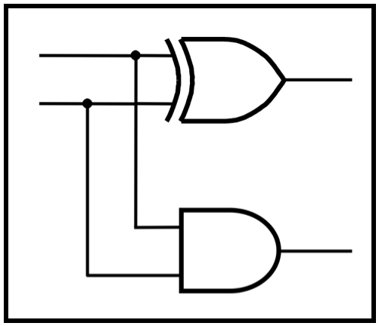
CprE 281:
Digital Logic
Instructor: Alexander Stoytchev
http://www.ece.iastate.edu/~alexs/classes/

Slide 2
Karnaugh Maps
CprE 281: Digital Logic
Iowa State University, Ames, IA
Copyright © Alexander Stoytchev

Slide 3
Administrative Stuff
HW4 is out
It is due on Monday Sep 19 @ 4 pm
It is posted on the class web page
I also sent you an e-mail with the link.

Slide 4
Administrative Stuff
Homework Solutions are posted on BlackBoard

Slide 5
Quick Review

Slide 6
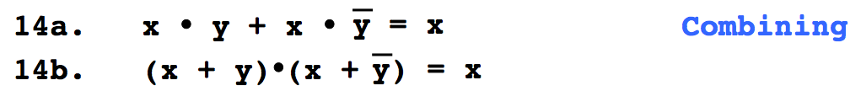
Do You Still Remember This
Boolean Algebra Theorem?

Slide 7
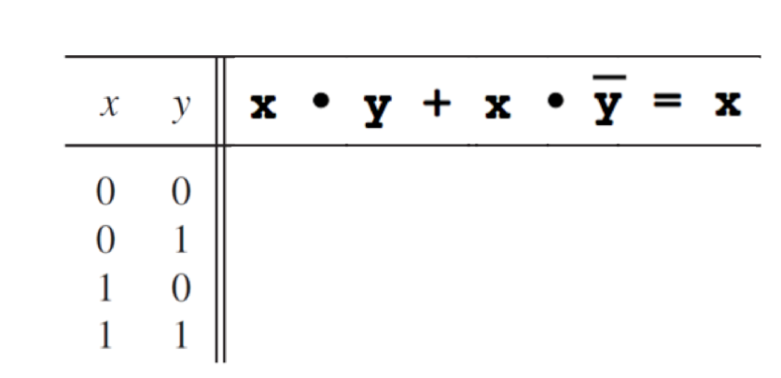
Let’s prove 14.a

Slide 8
Let’s prove 14.a
0
0
0
1

Slide 9
Let’s prove 14.a
0
0
0
0
0
1
1
0

Slide 10
Let’s prove 14.a
0
0
0
0
0
0
0
1
1
1
1
0

Slide 11
Let’s prove 14.a
0
0
0
0
0
0
0
0
0
1
1
1
1
1
0
1

Slide 12
Let’s prove 14.a
0
0
0
0
0
0
0
0
0
1
1
1
1
1
0
1
They are equal.

Slide 14
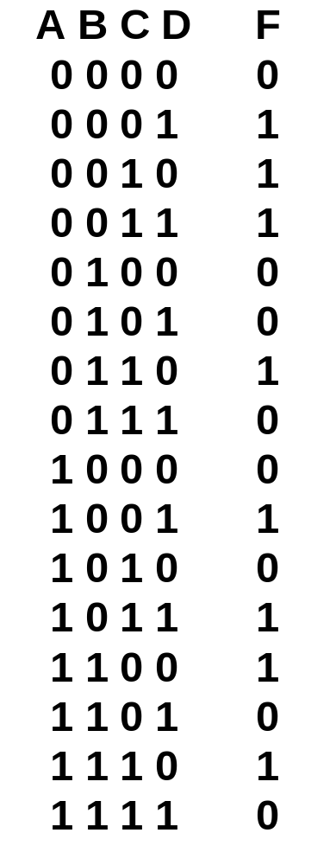
Motivation
An approach for simplifying logic expressions
How do we guarantee we have reached minimum SOP/POS representation?

Slide 15
Two-Variable K-Map

Slide 16
Karnaugh Map (K-map)
View the function in a visual form
Same information as truth table
Easier to group minterms
x
1
x
2
x
x
1
0
0
m
2
0
1
0
0
1
m
0
m
m
1
0
2
1
0
m
2
1
m
m
1
1
m
1
3
3
(a) Truth table
(b) Karnaugh map
[ Figure 2.49 from the textbook ]

Slide 17
Minterms
x
1
x
2
x
x
m
m
m
m
1
2
0
1
2
3
0
0
m
0
0
1
0
0
0
0
0
1
m
0
1
0
1
0
0
1
1
0
m
1
0
0
0
1
0
2
1
1
m
1
1
0
0
0
1
3

Slide 18
Minterm Example
x
1
x
2
x
x
m
m
m
m
m
+ m
1
2
0
1
2
3
1
3
0
0
0
0
0
1
0
0
0
0
0
1
1
0
1
0
1
0
0
1
1
0
0
1
0
0
0
1
0
0
1
1
1
1
1
0
0
0
1
1

Slide 19
Minterm Example
x
1
x
2
x
x
m
m
m
m
m
+ m
1
2
0
1
2
3
1
3
0
0
0
0
0
1
0
0
0
0
0
1
1
0
1
0
1
0
0
1
1
0
0
1
0
0
0
1
0
0
1
1
1
1
1
0
0
0
1
1
_
x₁x₂ + x₁x₂ = x₂

Slide 20
Grouping Example
x
1
x
1
x
2
x
2
0
1
0
1
0
1
0
0
0
0
1
0
0
1
1
0
m₀
m₁

Slide 21
Grouping Example
x
1
x
1
x
1
x
2
x
2
x
2
0
1
0
1
0
1
0
1
0
0
0
0
0
1
0
+
=
1
0
0
1
1
0
1
1
0
m₀
+
m₁
=
m₀ + m₁

Slide 22
Grouping Example
x
1
x
1
x
1
x
2
x
2
x
2
0
1
0
1
0
1
0
1
0
0
0
0
0
1
0
+
=
1
0
0
1
1
0
1
1
0
m₀
+
m₁
=
m₀ + m₁

Slide 23
Grouping Example
x
1
x
1
x
1
x
2
x
2
x
2
0
1
0
1
0
1
0
1
0
0
0
0
0
1
0
+
=
1
0
0
1
1
0
1
1
0
m₀
+
m₁
=
m₀ + m₁
_
_
_
_
x₁x₂
+
x₁x₂
=
x₁
Property 14a (Combining)

Slide 24
Grouping Rules
Group “1”s with rectangles
Both sides a power of 2:
  1x1, 1x2, 2x1, 2x2, 1x4, 4x1, 2x4, 4x2, 4x4
Can use the same minterm more than once
Can wrap around the edges of the map
Some rules in selecting groups:
  Try to use as few groups as possible to cover all “1”s.
  For each group, try to make it as large as you can (i.e., if you can use a 2x2, don’t use a 2x1 even if that is enough).

Slide 25
Two-Variable K-map
x
1
x
2
x
x
1
0
0
m
2
0
1
0
0
1
m
0
m
m
1
0
2
1
0
m
2
1
m
m
1
1
m
1
3
3
(a) Truth table
(b) Karnaugh map
[ Figure 2.49 from the textbook ]

Slide 26
Step-By-Step Example
x
1
x
2
0
0
1
0
1
1
1
0
0
1
1
1

Slide 27
1. Draw The Map
x
1
x
2
x
x
1
0
0
1
2
0
1
0
1
1
0
1
0
0
1
1
1
1

Slide 28
2. Fill The Map
x
1
x
2
x
x
1
m
0
0
1
2
0
1
0
m
0
1
1
m
m
1
0
0
2
m
1
0
0
2
m
1
m
m
3
1
1
1
1
3

Slide 29
2. Fill The Map
x
1
x
2
x
x
1
m
0
0
1
2
0
1
0
m
0
1
1
1
0
1
0
m
1
0
0
2
m
1
1
1
3
1
1
1

Slide 30
3. Group
x
1
x
2
x
x
1
m
0
0
1
2
0
1
0
m
0
1
1
1
0
1
0
m
1
0
0
2
m
1
1
1
3
1
1
1

Slide 31
3. Group
x
1
x
2
x
x
1
m
0
0
1
2
0
1
0
m
0
1
1
1
0
1
0
m
1
0
0
2
m
1
1
1
3
1
1
1

Slide 32
3. Group
x
1
x
2
x
x
1
m
0
0
1
2
0
1
0
m
0
1
1
1
0
1
0
m
1
0
0
2
m
1
1
1
3
1
1
1

Slide 33
4. Write The Expression
x
1
x
2
x
x
1
0
0
1
2
0
1
0
1
1
0
1
0
1
0
0
1
1
1
1
1
1

Slide 34
4. Write The Expression
x
1
x
2
x
x
1
0
0
1
2
0
1
0
1
1
0
1
0
1
0
0
1
1
1
1
1
1
_
x₁ + x₂

Slide 35
Writing The Expression
Find which variable is constant
x
1
x
2
_
0
1
x₁ is constant
0
1
0
1
1
0

Slide 36
Writing The Expression
Find which variable is constant
x
1
x
2
0
1
x₁ is constant
0
0
1
1
0
1

Slide 38
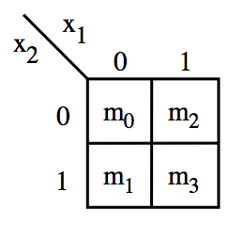
These are all valid groupings

Slide 39
These are also valid
But try to use larger rectangles if possible.

Slide 40
This one is valid too
In this case the result is the constant function 1.

Slide 41
Why are these two not valid?

Slide 42
Let’s Find Out
x
1
x
1
x
2
x
2
0
1
0
1
0
1
0
0
0
0
1
0
0
1
0
1
m₀
m₃

Slide 43
Let’s Find Out
x
1
x
1
x
1
x
2
x
2
x
2
0
1
0
1
0
1
0
1
0
0
0
0
0
1
0
+
=
1
0
0
1
0
1
1
0
1
m₀
+
m₃
=
m₀ + m₃

Slide 44
Let’s Find Out
x
1
x
1
x
1
x
2
x
2
x
2
0
1
0
1
0
1
0
1
0
0
0
0
0
1
0
+
=
1
0
0
1
0
1
1
0
1
m₀
+
m₃
=
m₀ + m₃

Slide 45
Let’s Find Out
x
1
x
1
x
1
x
2
x
2
x
2
0
1
0
1
0
1
0
1
0
0
0
0
0
1
0
+
=
1
0
0
1
0
1
1
0
1
m₀
+
m₃
=
m₀ + m₃
_
_
_
_
x₁x₂
+
x₁x₂
=
+
x₁x₂
x₁x₂
We can’t use Property 14a here. This can’t be simplified.

Slide 46
Three-Variable K-Map

Slide 47
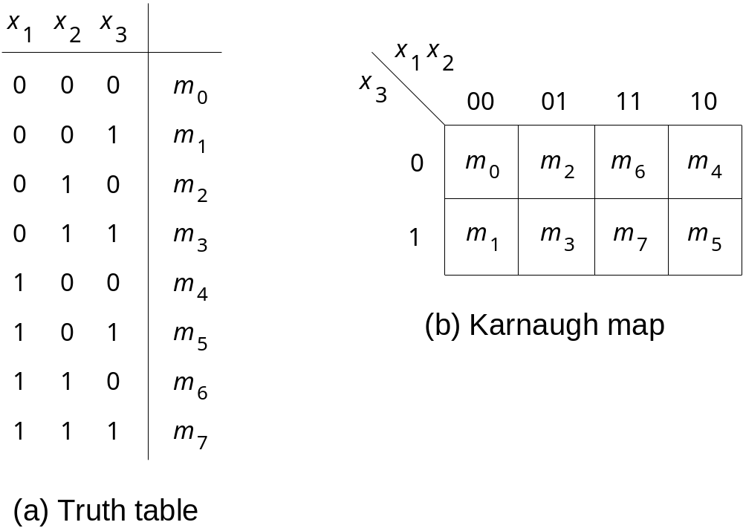
Location of three-variable minterms
[ Figure 2.51 from the textbook ]

Slide 48
Location of three-variable minterms
Notice the placement of
  Variables
  Binary pair values
  Minterms

Slide 49
Gray Code
Sequence of binary codes
Vary by only 1 bit
000
001
011
010
110
111
101
100
00
01
11
10

Slide 50
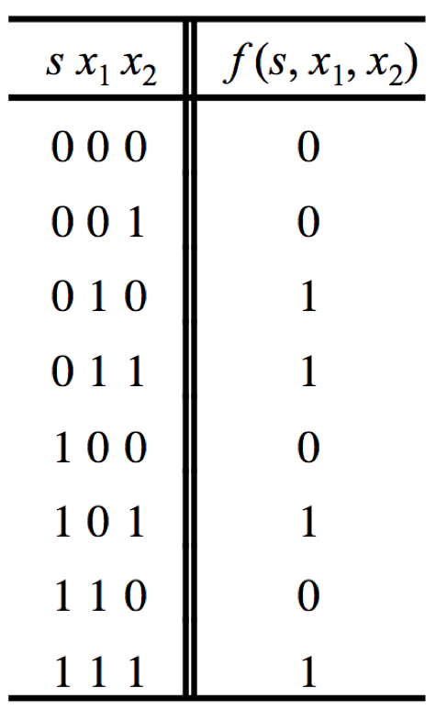

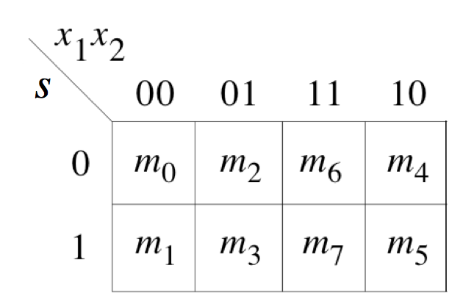
Gray Code & K-map
s x₁
x₂

Slide 51
Gray Code & K-map
s x₁
x₂
000
010
110
100
001
011
111
101

Slide 52

Adjacency Rules
adjacent
columns

Slide 53
These are valid groupings

Slide 54
These are valid groupings

Slide 55
These are valid groupings

Slide 56
These are valid groupings

Slide 57
These are valid groupings

Slide 58
This is a valid grouping

Slide 59
Some invalid groupings

Slide 60
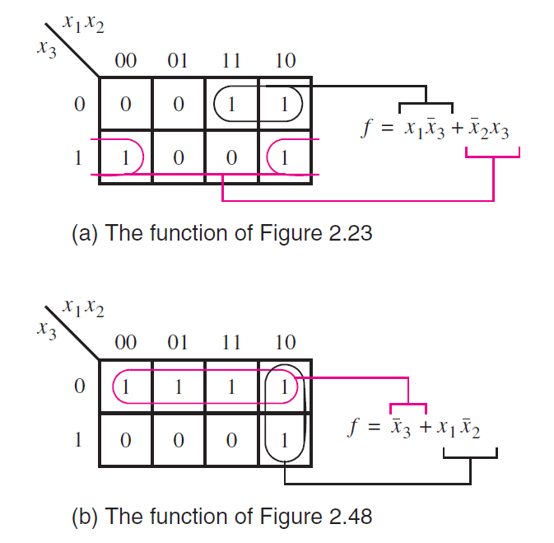
Examples of three-variable Karnaugh maps
[ Figure 2.52 from the textbook ]

Slide 61
Four-Variable K-Map

Slide 62
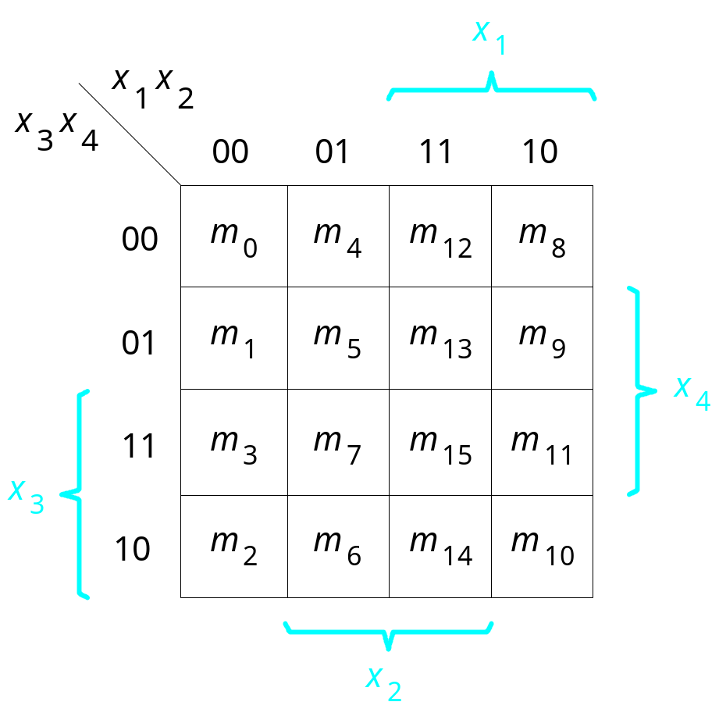
A four-variable Karnaugh map
[ Figure 2.53 from the textbook ]

Slide 63
A four-variable Karnaugh map
x1 | x2 | x3 | x4
0 | 0 | 0 | 0 | m0
0 | 0 | 0 | 1 | m1
0 | 0 | 1 | 0 | m2
0 | 0 | 1 | 1 | m3
0 | 1 | 0 | 0 | m4
0 | 1 | 0 | 1 | m5
0 | 1 | 1 | 0 | m6
0 | 1 | 1 | 1 | m7
1 | 0 | 0 | 0 | m8
1 | 0 | 0 | 1 | m9
1 | 0 | 1 | 0 | m10
1 | 0 | 1 | 1 | m11
1 | 1 | 0 | 0 | m12
1 | 1 | 0 | 1 | m13
1 | 1 | 1 | 0 | m14
1 | 1 | 1 | 1 | m15

Slide 64
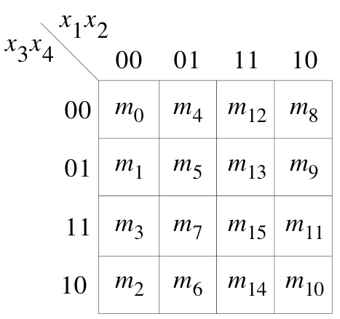
Adjacency Rules
adjacent
rows
adjacent
columns
adjacent
columns

Slide 65
Some Valid Groupings

Slide 66
Some Valid Groupings

Slide 67
Some Valid Groupings

Slide 68
Some Invalid Groupings
All sides must be powers of 2.

Slide 69
Some valid Groupings
All sides must be powers of 2.

Slide 70
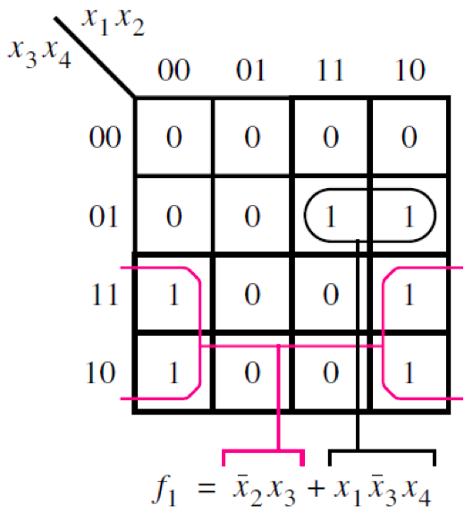
Example of a four-variable Karnaugh map
[ Figure 2.54 from the textbook ]

Slide 71
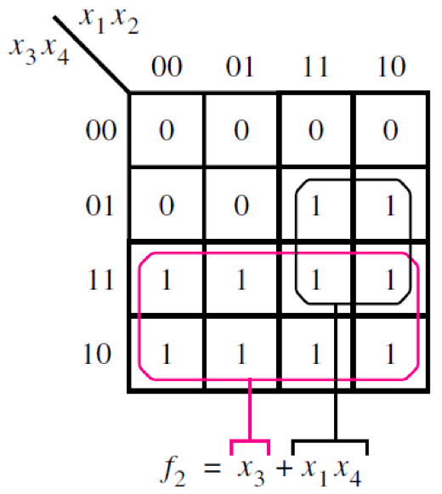
Example of a four-variable Karnaugh map
[ Figure 2.54 from the textbook ]

Slide 72
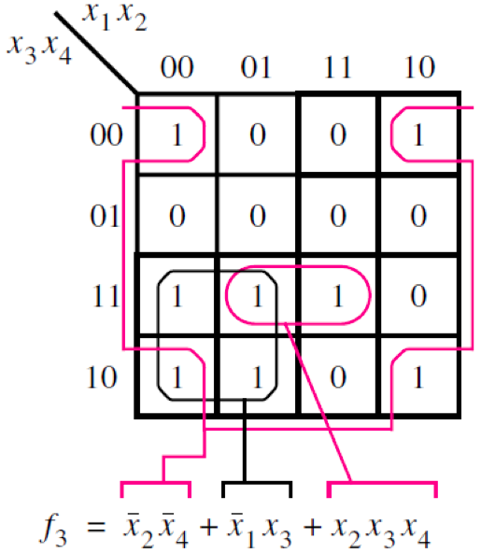
Example of a four-variable Karnaugh map
[ Figure 2.54 from the textbook ]

Slide 73
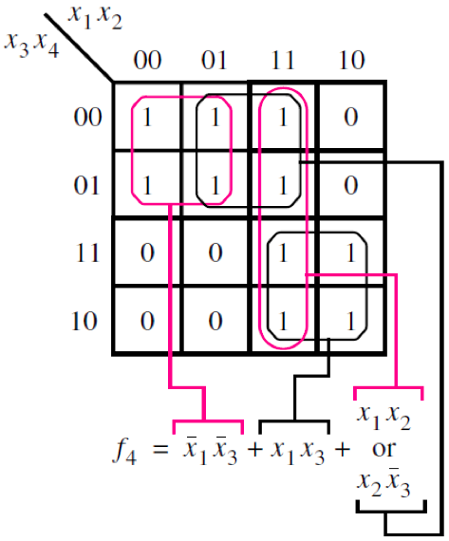
Example of a four-variable Karnaugh map
[ Figure 2.54 from the textbook ]

Slide 74
Five-Variable K-Map

Slide 75
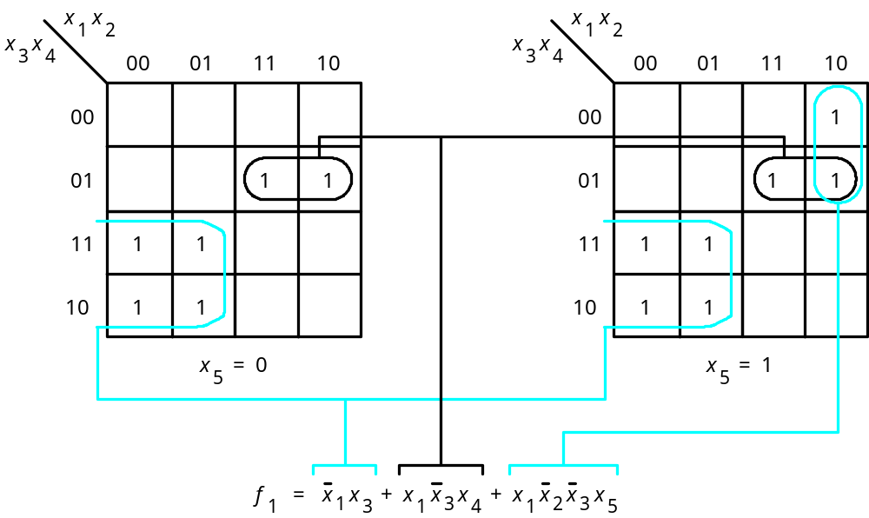
A five-variable Karnaugh map
[ Figure 2.55 from the textbook ]

Slide 76
Questions?

Slide 77
THE END

